Slide 1
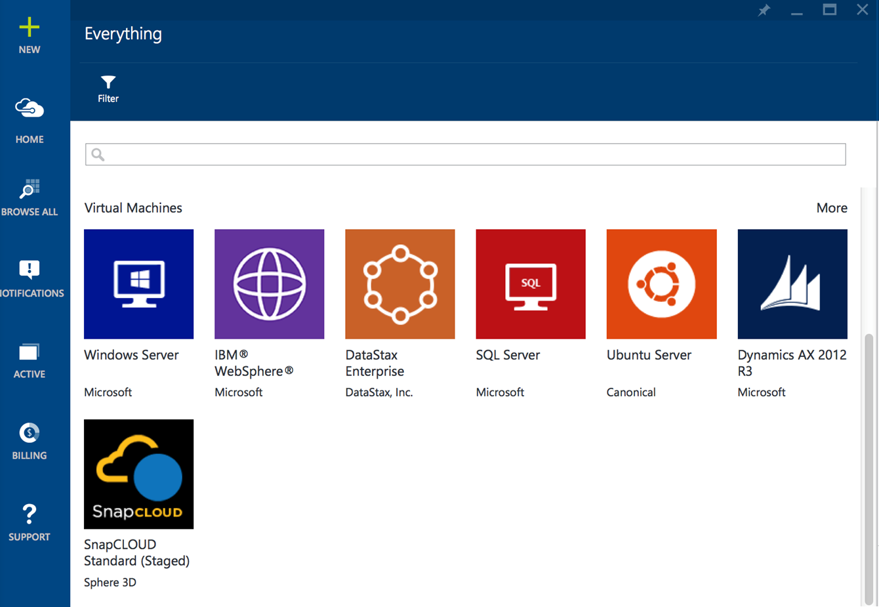
What is SnapCLOUD?
Primary Data Storage on Azure Marketplace with guaranteed throughput in IOPs and bandwidth
  File (NFS, CIFS) and Block Storage
  Fully functional enterprise class feature set including snapshots, thin provisioning, secure access control etc.
  Private and hybrid cloud enabled

Slide 2
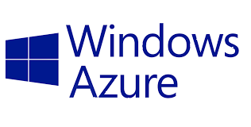
Hybrid Cloud
Example: On-premise storage dedicated to production environment while development & test workloads moved to cloud
Eliminate Risks to production environment
Eliminate investment for second infrastructure
Save time & resources
NFS, CIFS
SNAPCLOUD
Accelerate projects by providing the infrastructure in minutes
Eliminate over-provisioning costs
30%+ cost reduction with pay for only what you use model
SNAPCLOUD
Off- load additional capacity burst to the cloud. Example:
A new project
A new business opportunity
Setting up a new business office
NFS, CIFS
On-Premise Snap Storage

Slide 3
Personal Cloud
Eliminate Risks to production environment
Eliminate investment for second infrastructure
Save time & resources
Need to share data between devices, users, securely,
SNAPCLOUD
CAN SHARE BETWEEN DEVICES
CAN SHARE BETWEEN USERS
INTERNET ACCESS
ALL DEVICES HAVE ACCESS TO BUSINESS DOCS
INTERNET ACCESS
ACCESS TO BUSINESS DOCS

Slide 4
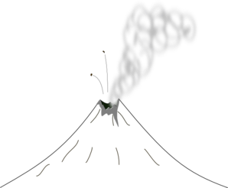


Disaster Recovery in the CLOUD
Example: On-premise storage dedicated to production environment while development & test workloads moved to cloud
Eliminate Risks to production environment
Eliminate investment for second infrastructure
Save time & resources
SNAPCLOUD
Replication
On-premise

Slide 5

SnapCLOUD Difference
Expand storage capacity simply by adding disks to the storage pool
Get data management solution at your terms
Build a Hybrid Cloud in minutes. Replicate data to and from physical data center; integrate with on-premise active directory and LDAP authentication
Securely access any device, anywhere with business policy enforcement. Sync and share functionality enables data sharing between users and devices.
Notes:
Icons here too

Slide 6
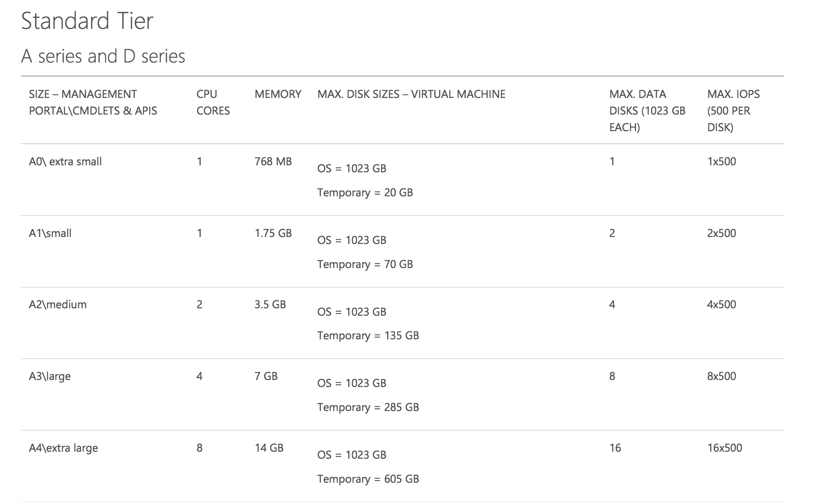
Sizing and Pricing/Quoting
Start with how much data is needed and get guaranteed throughput requirements

Slide 7


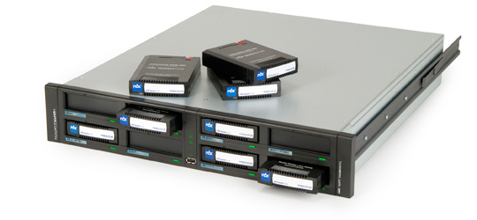
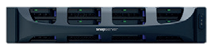

Jump Start Your Revenue Stream
*
Pay $0 for SnapCLOUD for 30 days for existing and new Snap customers
*Only on SnapCLOUD not on compute and storage by Microsoft
SnapScale
SnapServer XSR
SnapServer XSD
RDX

