Slide 1

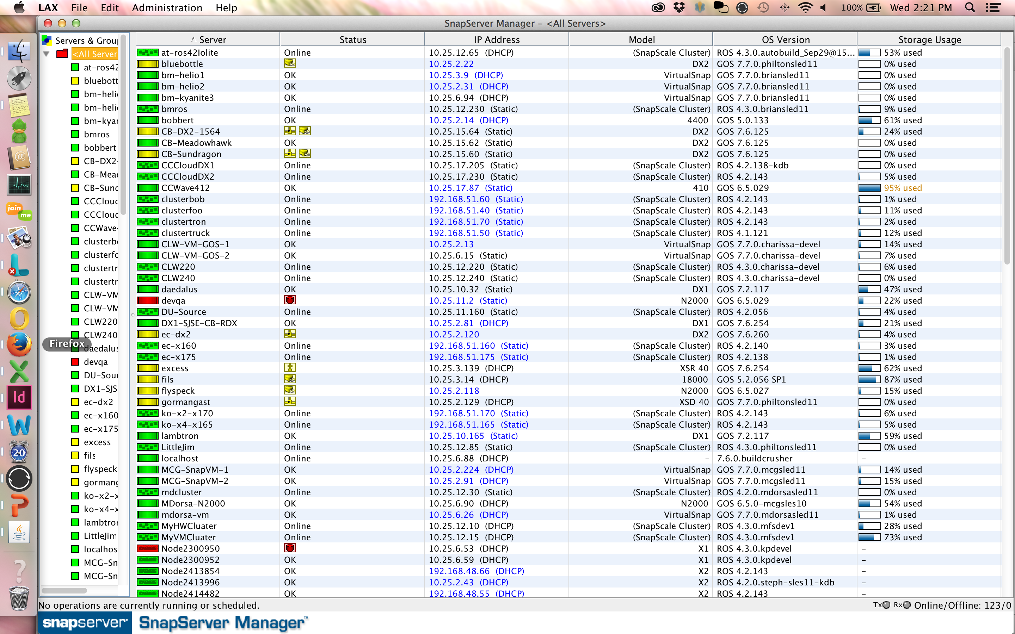

Hybrid Storage Solution
Cloud Storage Solution
Fully functional Enterprise class, workload optimized NAS Storage on premise and in the cloud with integrated data replication
Enables end to end data protection with built-in snapshots, continuous replication, back up to tape or RDX
Delivers data fluidity with ease of data migration or replication between mobile devices, on-premise storage and cloud
Lowers Infrastructure through pay for for what is used and lower $/GB
Unified, simplified and common management for cloud & premise
Customer Benefits:
Drive business growth and stay ahead of the competition with an infrastructure that is available on demand
Get secure access to confidential data on the go
Reduce operational expenses through single management of workload optimized on-premise and cloud storage
Private Cloud
Cloud Storage
Mobile
At-a-glance
Free
Single Mgmt Pane for all Snap
Scale-Out
Desktop
SnapStorage Manager
On-premise storage
Enterprise Apps
Ent. Apps
Expandable storage
File & Block
SnapServer
Proven
Worldwide volume leader in NAS solutions
350,000+ units installed and 35+ Petabytes deployed
Used by more than half of the Fortune 500
Honored with more than 80 industry product awards
One of the most recognized brands in the industry
Warranty & Support Options
Standard 3 year bronze warranty for on-premise with upgrade to silver, gold, and platinum uplifts
On-demand community support for cloud storage with upgrade to bronze, silver, gold, and platinum uplifts
Infinite storage
Self-learning
Self-healing
SnapScale
Primary datastore
$0 upfront cost
Cloud DR
Unique Competitive Advantages
Best Active Directory security integration of any non-Windows based NAS server
Handles mixed-client OS environments better than anything else by use of ID mapping and Windows-only security trees.
High performance snapshot technology allows administrators to recover files from different points-in-time, and has the best capacity utilization, and best performance when comparing to any form of competitive snapshot technology.
Includes Snap EDR, an enterprise class remote replication software package that easily moves files between multiple SnapServers, SnapCLOUD, SnapScale and endpoints for a complete disaster recovery solution.
Integrated Private cloud functionality through Sync 2.0 that includes shadow files, smart synchronization, secure sharing.
Integrated compatibility with RDX QuikStor backup hardware for fast, direct backups in a ruggedized disk system.
SnapCLOUD
File shares
Quiet
Economical
XSD40

