Slide 1


Introducing SnapCLOUD

Slide 2

Agenda
Company Overview
Snap Storage Portfolio
What is SnapCLOUD
Use Cases
Competitive Differentiation
Opportunity sizing & Pricing
How to Sell SnapCLOUD
What’s in it for the partner
Tapping into the opportunity

Slide 3

Sphere 3D (NASDAQ:ANY) – Who Are We
SPHERE 3D
A quick overview
OUR VISION
OUR REACH
WHAT WE DO
Through our acquisitions and organic growth we partner with over 20,000 resellers in 90 countries and serve over 100,000 customers.
We provide the technology to move your apps, data, and workflow to the cloud so you can use them anywhere on any device…anytime.
Power The Next Cloud
THE TEAM
WHOM WE DO IT FOR
A well seasoned team of executives that have experience building companies from start up all they way through to multi-billion dollar entities over the last 30 years
ANY-cloud, ANY-platform,
ANY- application ANY- Data on ANY-device
Help modernize IT for SMBs as well as large enterprises across multiple verticals. We equip ISV’s and data centers with new capabilities and economics for delivering cloud and mobile ready software.
OUR FRIENDS
Strategic partnerships with industry leaders including Microsoft, VMWare, Intel, AMD and Nvidia

Slide 4

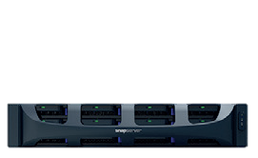
Snap Storage Portfolio – Optimized for every workload
Saves Time & Resource
Unified Management: Online, Integrated, user experience focused
SSM (Snap Storage Manager) – Device Discovery & Management
Standardize User Exp.
Consistent Functionality
Failure Resiliency
Space Saving
Snapshots
Disaster Recovery
Security
Perf.
Optimized
Scale-Out
Enterprise Apps
Desktop Storage
Enterprise Apps
SnapServer XSD
Storage
Optimized
SnapScale
SnapServer XSR
SnapServer XSD
SnapCLOUD
Specialized Functions
Infinite storage
Self-learning
Self-healing
File and block
Low latency
Expandable storage
File Shares
Quiet
Economical
$0 upfront cost
Cloud DR

Slide 5
Snap Storage Portfolio -- Key Benefits
REDUCE
STORAGE COSTS
By 30%
Failure resiliency reduces downtime
Space efficiency
No additional licenses
Integrated enterprise-class features
Simple, intuitive, single management pane
Lower cost/GB
MANAGE
DATA GROWTH
With no additional headcount
MANAGE DATA GROWTH
OPTIMIZE
WORKLOAD
 | SCALE | XSR | XSD | CLOUD
High Throughput /Bandwidth | ✓
Low Latency Business Applications |  | ✓ |  | ✓
SOHO File Sharing with integrated Print Server |  | ✓ | ✓ | ✓
Personal Cloud Solution with controlled access | ✓ | ✓ | ✓ | ✓
Hybrid Cloud | ✓ | ✓ | ✓ | ✓
SNAPSCALE
24-100 PB
100 PB
SNAPSERVER XSR
8-500 TB
OPTIMIZE
WORKLOAD
NO INFRASTRUCTURE SILOS
24 TB
SNAPSERVER XSD
4 -24TB
SNAPCLOUD
100 GB-16TB
100 GB

Slide 6
Start Anywhere with Any Snap Storage Product
Cloud storage
Desktop storage
CLOUD
SMALL/HOME OFFICE
SNAPSERVER
XSD
PRINT
SERVER
SNAPCLOUD
MOBILE
On-premise storage
SNAPSERVER
EMAIL
SERVER
MEDIUM OFFICES
Scaled NAS storage
On-premise storage
ENTERPRISE
SNAPSCALE
MEDIA
SERVER
SNAPSERVER
VIRTUAL
MACHINE

Slide 7
The Cloud Opportunity
“Roughly one quarter of SBs and one half of MBs plan to shift their budgets to more cloud spending over on-premise spending”
-AMI
Reduction in Costs for SMBs moving to IaaS¹
Annual Recurring
Revenue for MSPs²
-50%
+28% YoY
“Partners are transforming their business to increase the services they offer to SMB”
- Forrester Research, 2013
Windows Server 2012 Partner TEI
$
McKinsey&Co Winning in SMB Cloud, Jul 2011
Forrester MSP Market Overview, May 2012
AMI Partners Mar 25th 2012, US SMB Trends & Server Market Insights
Notes:
The cloud is transforming how businesses consume IT today by offering consumption-based resources and services that can scale up or down as needed. This is an especially appealing value proposition for SMBs, as they can take advantage of a scale that was previously cost-prohibitive. In a McKinsey study, SMBs were able to reduce costs by 50% by moving to an IaaS solution. According to AMI, roughly one quarter of SBs and one half of MBs plan to shift their budgets to more cloud spending over on-premises spending. This shift is creating new revenue streams for partners as they move to cloud-enabled solutions and services. A Forrester study found annual recurring revenue for MSPs growing at 28% year-over-year.

Slide 8
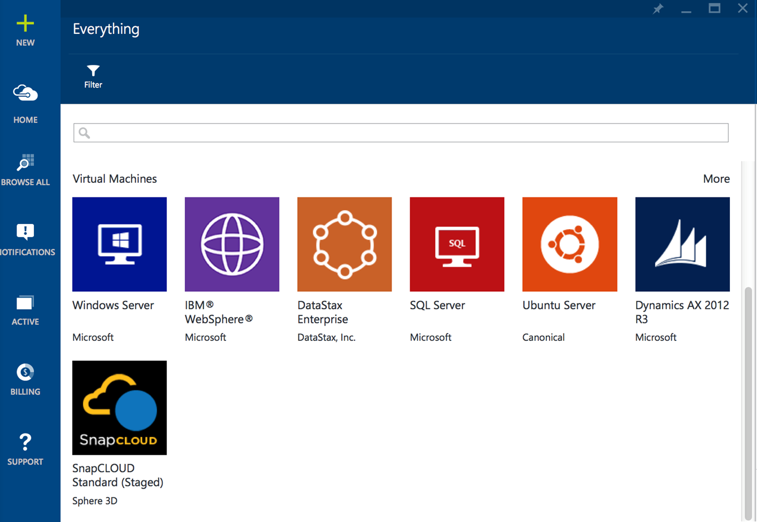
What is SnapCLOUD?
Fully functional SnapServer OS in the cloud
Available on azure marketplace
Runs on VM with storage disks attached to the VM

Slide 9
What is SnapCLOUD?
Features | Benefits
Unified Storage SAN/NAS - Both block and file NFS exports NFS host access control, NFS LDAP authentication CIFS/Samba/Windows shares | Flexibility to work with any application
Optimization of resources Thin-provisioning | Reduce storage cost. For example if you have 10 users each assigned 1TB of storage with utilization varying from 10GB to 500GB. Then you can deploy 4-5TB of storage and save over 100% in costs.
Space savings by using storage layer protection | Reduce storage costs by 40%
Data Protection Storage snapshots, Automatic snapshot pruning, High performance snapshots | Enterprise-class data protection suite. Same level of protection ason-premise storage
Expandable storage | Pay for only what you need
HYBRID CLOUD Replicate data to and from on-premise storage Integrate with on-premise LDAP and Active Directory | Seamless extension into the cloud
Sync and Share | Secure Data access anywhere, any Device

Slide 10
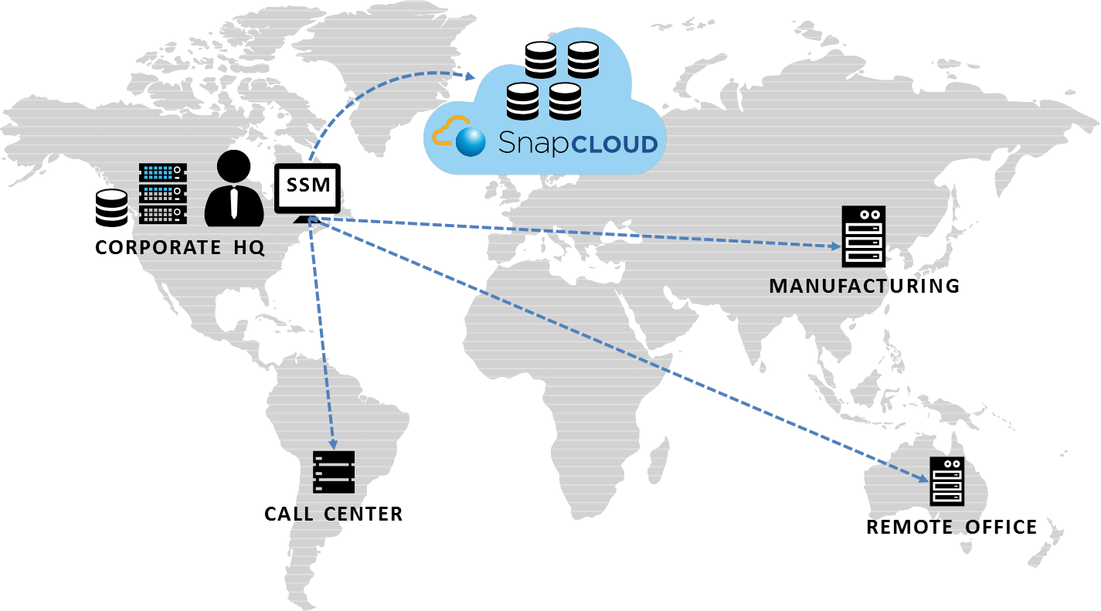
SnapCLOUD Use Cases
IT Resources On Demand
Secure Access. Anywhere. Any Device.
Centralized Management
  With SnapCLOUD, dynamically expand storage into the cloud with the same features and operations as on-premise storage. Pay for only what you use.
  SnapCLOUD enables secure and easy access to data among devices and users. Eliminates risky sharing of confidential material in public clouds.
  Snap Storage Manager enables management of all Snap Storage products through a single pane.
Notes:
At launch, we will focus on a couple of key scenarios that make sense for SMB customers and simplify the opportunity for our VARs.
Here are three great examples of how to offer profitable new services built on Microsoft Azure.
Offer data backup in the cloud – this is our lead scenario
With Azure, you can provide easy, scalable data backup in the cloud for a range of applications, such as file servers, SharePoint, SQL Server, and Exchange. For improved data protection, you can offer encrypted backups and know that data is backed up on Azure’s global geo-redundant datacenters. You also have the flexibility to quickly and easily provision more storage for your customers as needed.
Deploy applications within virtual machines
Azure also opens up the opportunity to help customers deploy applications in the cloud by hosting them in Azure VMs. Windows Server 2003 End of Life is on July15th, 2015. This presents a huge opportunity to drive the IaaS scenarios. With Azure, applications can be deployed quickly by moving them into an Azure VM. There are no up front infrastructure costs, you reduce IT management, and the application has scale up or down as needed.
Host websites on Azure – this is more of a niche scenario for partners that host websites
Microsoft Azure also offers a perfect platform for leveraging the cloud to deploy scalable websites. Hosting a website on Azure means that infrastructure management is covered, and you and your customers get the peace of mind from leveraging Microsoft’s global network of managed datacenters.

Slide 11
Target Use Cases
Enterprise Cloud Storage
  SME or large enterprise seeking to implement enterprise wide repository of data for sync and share
Enterprise DR
  SME’s or large Enterprises looking for recover from any type of disaster or site failure. Ensure business continuity by having corporate data secured in the cloud.
My Sync and Share
  SMB, SME’s or Enterprise workgroup seeking to share data securely and at high performance
Workgroup DevOps
  SME or Enterprise workgroup SW developers looking for shared storage to store SW builds and files

Slide 12

SnapCLOUD Difference
Expand storage capacity simply by adding disks to the storage pool
Get data management solution at your terms
Build a Hybrid Cloud in minutes. Replicate data to and from physical data center; integrate with on-premise active directory and LDAP authentication
Securely access any device, anywhere with business policy enforcement. Sync and share functionality enables data sharing between users and devices.
Notes:
Icons here too

Slide 13
SnapCLOUD Difference
Use Cases
 | SnapCLOUD | Competitors
Expand and grow storage on demand in the cloud | ✓ | -
Extension of the on-premise storage | ✓ | -
Secure access to business data anywhere any device. | ✓ | -

Slide 14
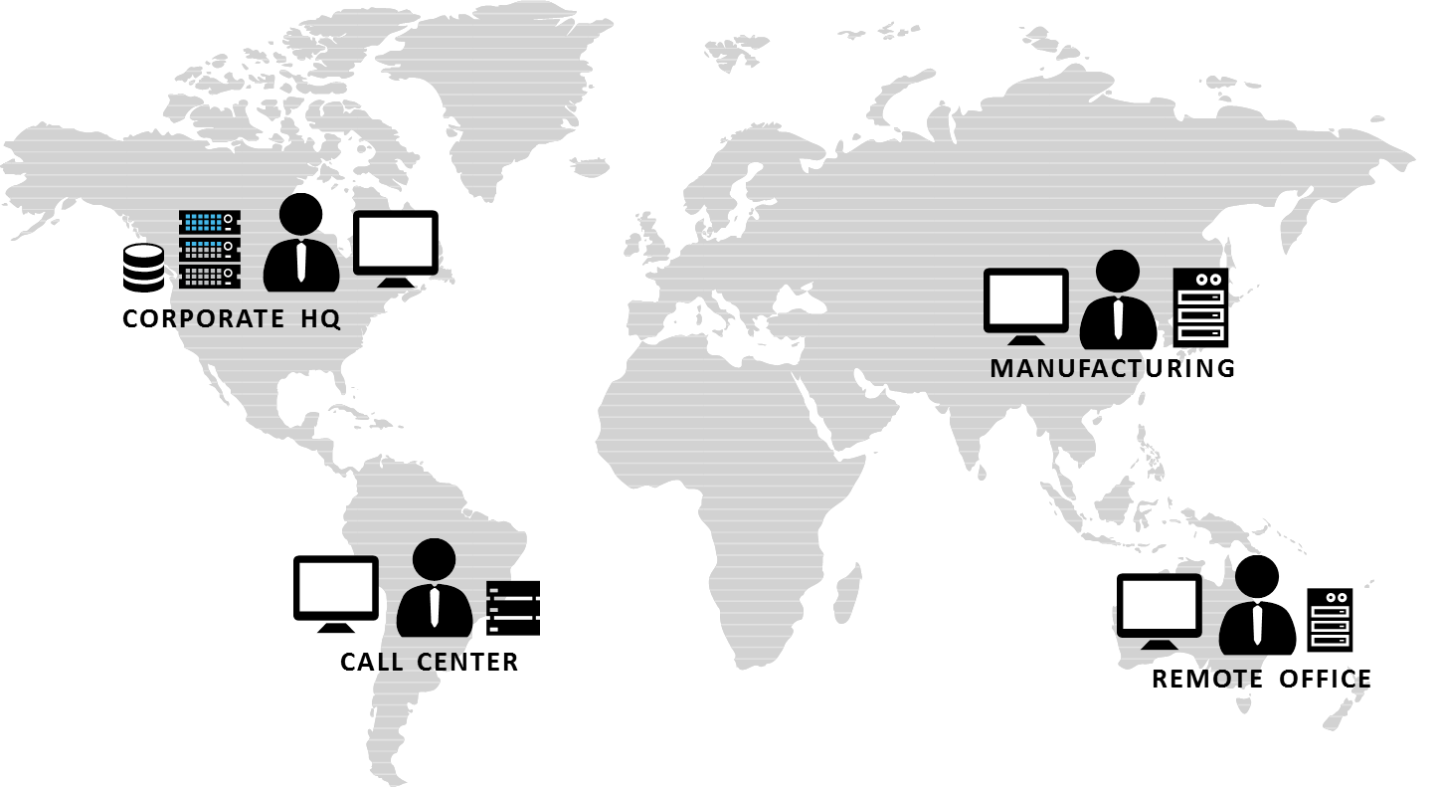
Customer Challenges
IT Resources On Demand
Accessibility Across Devices
Distributed Enterprise
  The business requirements on IT infrastructure like compute and storage can vary drastically from one time to another.
  Secure access to company files
  and business applications on the company’s internal network is still
  a challenge.
  Different offices have different infrastructure managed by different tools needing more time and resources
Notes:
At launch, we will focus on a couple of key scenarios that make sense for SMB customers and simplify the opportunity for our VARs.
Here are three great examples of how to offer profitable new services built on Microsoft Azure.
Offer data backup in the cloud – this is our lead scenario
With Azure, you can provide easy, scalable data backup in the cloud for a range of applications, such as file servers, SharePoint, SQL Server, and Exchange. For improved data protection, you can offer encrypted backups and know that data is backed up on Azure’s global geo-redundant datacenters. You also have the flexibility to quickly and easily provision more storage for your customers as needed.
Deploy applications within virtual machines
Azure also opens up the opportunity to help customers deploy applications in the cloud by hosting them in Azure VMs. Windows Server 2003 End of Life is on July15th, 2015. This presents a huge opportunity to drive the IaaS scenarios. With Azure, applications can be deployed quickly by moving them into an Azure VM. There are no up front infrastructure costs, you reduce IT management, and the application has scale up or down as needed.
Host websites on Azure – this is more of a niche scenario for partners that host websites
Microsoft Azure also offers a perfect platform for leveraging the cloud to deploy scalable websites. Hosting a website on Azure means that infrastructure management is covered, and you and your customers get the peace of mind from leveraging Microsoft’s global network of managed datacenters.

Slide 15
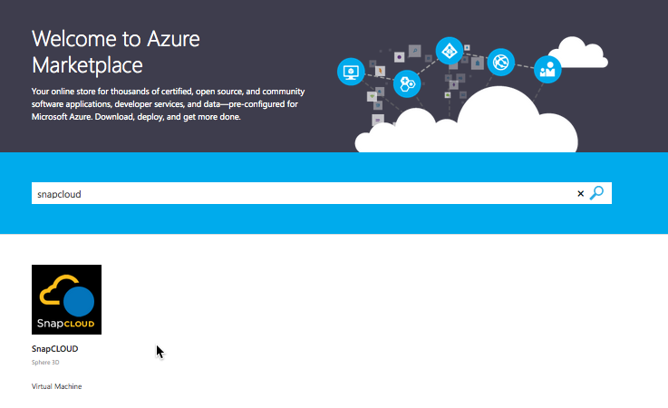
What is SnapCLOUD?
Fully functional SnapServer OS in the cloud
Available on azure marketplace
Runs on VM with storage disks attached to the VM

Slide 16

What is Microsoft Azure
Internal Only
An open and flexible cloud platform that enables you to quickly build, deploy, and manage solutions across a global network of Microsoft-managed datacenters.
Build applications using any language, tool, or framework
Integrate public cloud solution with the existing IT environment
99.95% monthly SLA
Automatic OS and service patching
Usage-based services
App services
Caching
Identity
Service bus
Media
CDN
Integration
HPC
Analytics
Compute
Virtual machines
Websites
Cloud services
Mobile services
Storage
SQL database
HDInsight
Tables
Blob storage
Network
Connect
Virtual network
Traffic manager
Notes:
Microsoft Azure is a cloud platform that enables you to quickly build, deploy, and manage solutions across a global network of Microsoft-managed datacenters.
It is open and flexible—you can build applications using any language, tool, or framework.
Azure also offers the unique ability to integrate public cloud solutions with the existing IT environment. This offers a real advantage over other platforms, which take an “all or none” strategy.
With Azure, you can count on your applications and services, with a 99.95% monthly SLA, and automatic OS and service patching.
Azure offers a wide range of usage-based services, including applications, compute, storage, and network services.
Microsoft will regularly introduce new services to Azure.

Slide 17



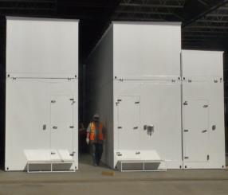
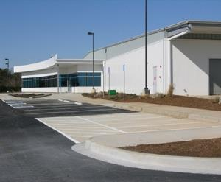

Microsoft Azure
Internal Only
kr
kr
$
€
руб
£
chf
$
₩
¥
TL
$
Global datacenters
Global support
Rp
Local account teams
$
R
Local currencies
$
$
  24 x 7 x 365 support Over 1 billion customers, 20 million businesses 90 markets worldwide
  280 years of combined industry experience in infrastructure, security, product dev, and global ops
Notes:
The scale of Microsoft Azure is truly global.
See the latest on http://azure.microsoft.com/en-us/regions/
There is a growing list of datacenters and currencies

Slide 18
SnapCLOUD Difference
Features
 | SnapCLOUD | SoftNAS
Unified Storage SAN/NAS - Both block and file | ✓ | ✓
NFS exports | ✓ | ✓
NFS host access control | ✓ | ✓
NFS LDAP authentication | ✓ | ✓
CIFS/Samba/Windows shares | ✓ | ✓
Active directory integration | ✓ | ✓
Active directory groups | ✓ | ✓
Optimization of resources | ✓ | -
Thin-provisioning | ✓ | ✓
Caching | ✓ | ✓
Space savings by using storage layer protection | ✓ | -
Data Protection | ✓ | -
Storage snapshots | ✓ | ✓
Automatic snapshot pruning | ✓ | ✓
High performance snapshots | ✓ | -
Change based replication for DR | ✓ | -

Slide 19
Opportunity Sizing
Microsoft Azure Infrastructure Spend Potential by Customer Use Cases
 | Initial - Kicking the tires | Monthly (Steady State) | Annual (Steady State) | Potential @ # of Opportunities | Assumed # of Opportunities
My Cloud Sync and Share | $94 | $289 | $3,471 | $1,735,680 | 500
Workgroup DevOps | $184 | $579 | $6,943 | $1,735,680 | 250
Enterprise Storage Cloud | $362 | $1,157 | $13,885 | $1,388,544 | 100
Enterprise DR | $1,152 | $2,747 | $32,967 | $1,648,349 | 50

Slide 20
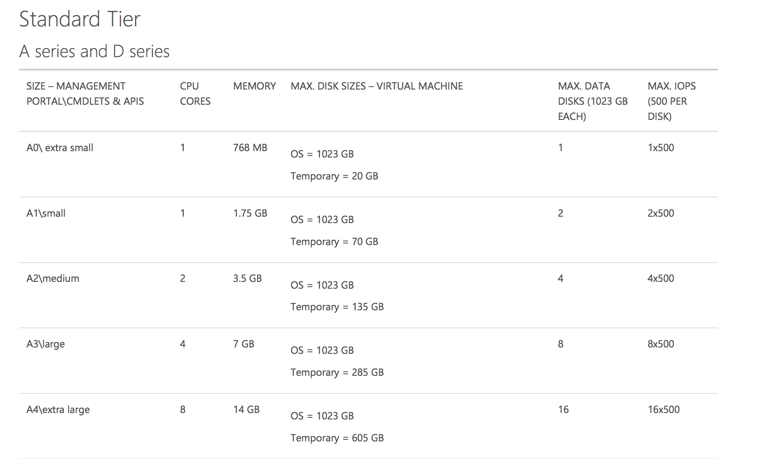
Sizing and Pricing/Quoting
Start with how much data is needed and get guaranteed throughput requirements

Slide 21
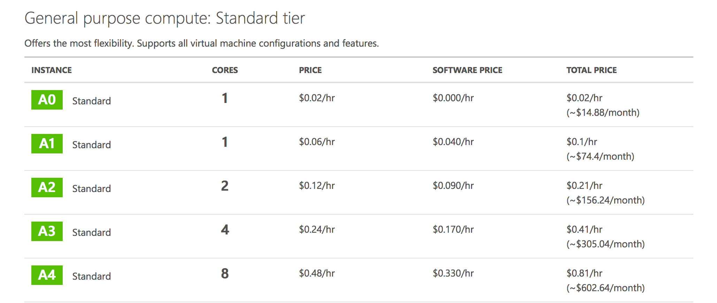
Sizing and Pricing/Quoting

Slide 22
Interest Generating Questions
Are you looking for efficient, cost-effective and flexible technology solution alternatives to your current Disaster Recovery solutions?
Are your employees using Dropbox, Boxnet or other public cloud solutions to enable data mobility?
Are you looking to lower costs through reducing your data center footprint?

Slide 23
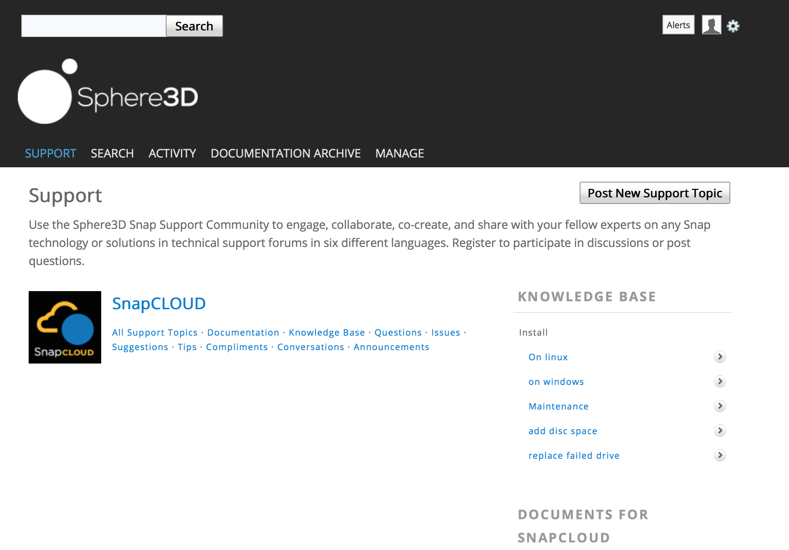

Support
http://community.overlandstorage.com/
Default Community Support
Support upgrade SKUs through the same channel as the hardware

Slide 24
Partner Compensation
Partners may be eligible for “Azure in Open” discount from their Distributor
For SnapCLOUD deployments on average ¾ of the customer spend is on Azure infrastructure
“Azure in Open” discounts are applicable to Azure infrastructure
 | Disti/VAR Margins
Capacity | Single SnapCLOUD | 20 SnapCLOUDs
2TB | $224 | $4,487
4TB | $449 | $8,974
8TB | $897 | $17,948
16TB | $1,795 | $35,896
32TB | $4,369 | $87,381
*Period-12 months & Disti/partner margins may vary

Slide 25
Double your revenue from the opportunities
Yesterday
Today
Data Replication
Data Replication
8TB
8TB
8TB
8TB
Deal Size in MSRP | ~$3100
Partner Margin | ~$620
Rev from this opportunity in 3 years | ~$620
Deal Size in MSRP | ~$1550+$370/month
Partner Margin | ~$310+$29/month
Rev from this opportunity in 3 years | ~$1350
Partner Margins may vary

Slide 26
How Do I Sell SnapCLOUD?
Already a Sphere3D Partner
Pay as You Go
Sell SnapCLOUD in
“Pay as You Go” model deployed in “Azure in Open” model
Zero upfront, cancel anytime
No long-term commitment
Yes
Have you sold products in Azure?
Yes
Are you a
Microsoft Partner?
Learn about
“Azure in Open”
Azure in Open
No
Flexibility with Volume Licensing through a familiar vehicle for SMBs
Opportunity for partners to earn margins/incentives
Become a Microsoft Partner
No
https://partner.microsoft.com/en-us/become-a-partner

Slide 27
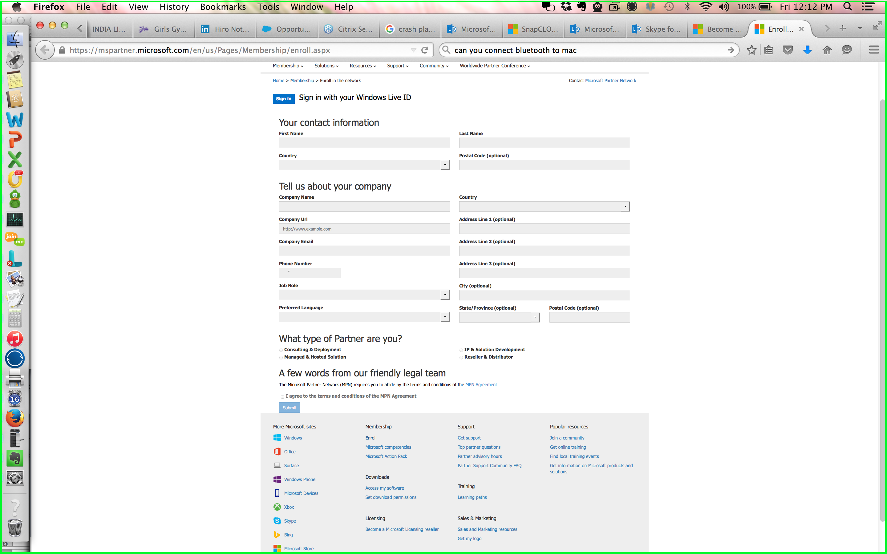
Becoming Microsoft Partner
Go to https://partner.microsoft.com/en-us/become-a-partner
Fill out a simple application
Allow 1-2 days to go through the regional service center
To become advanced level partners learn more about the Competencies or Action pack

Slide 28
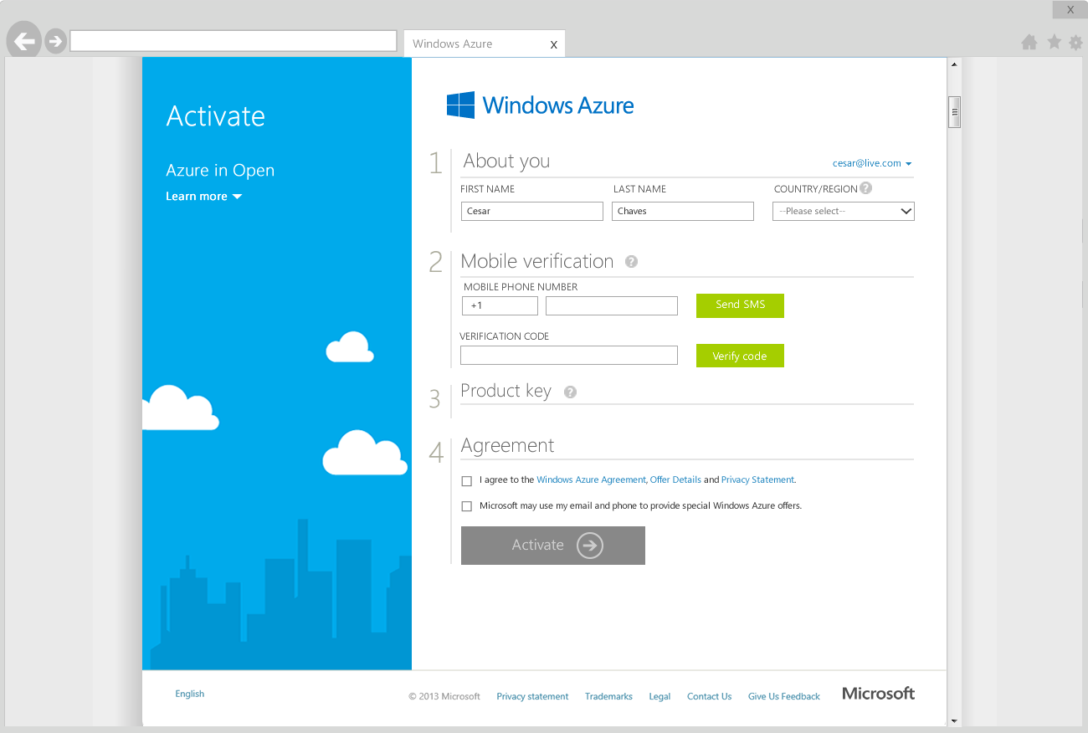
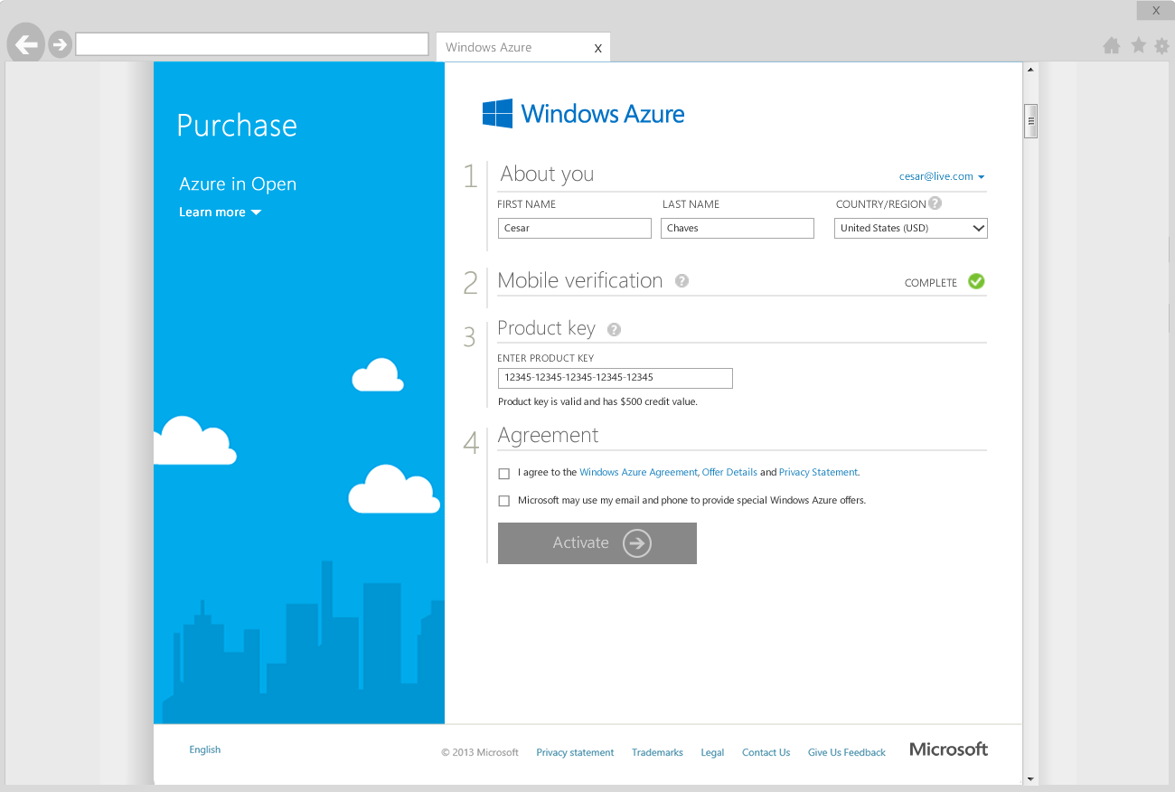
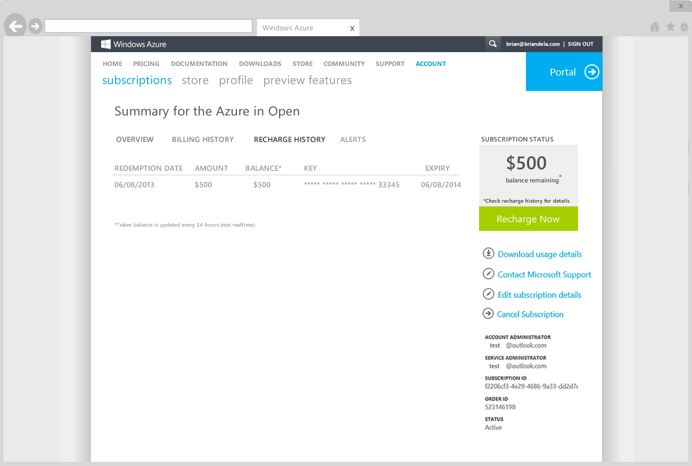
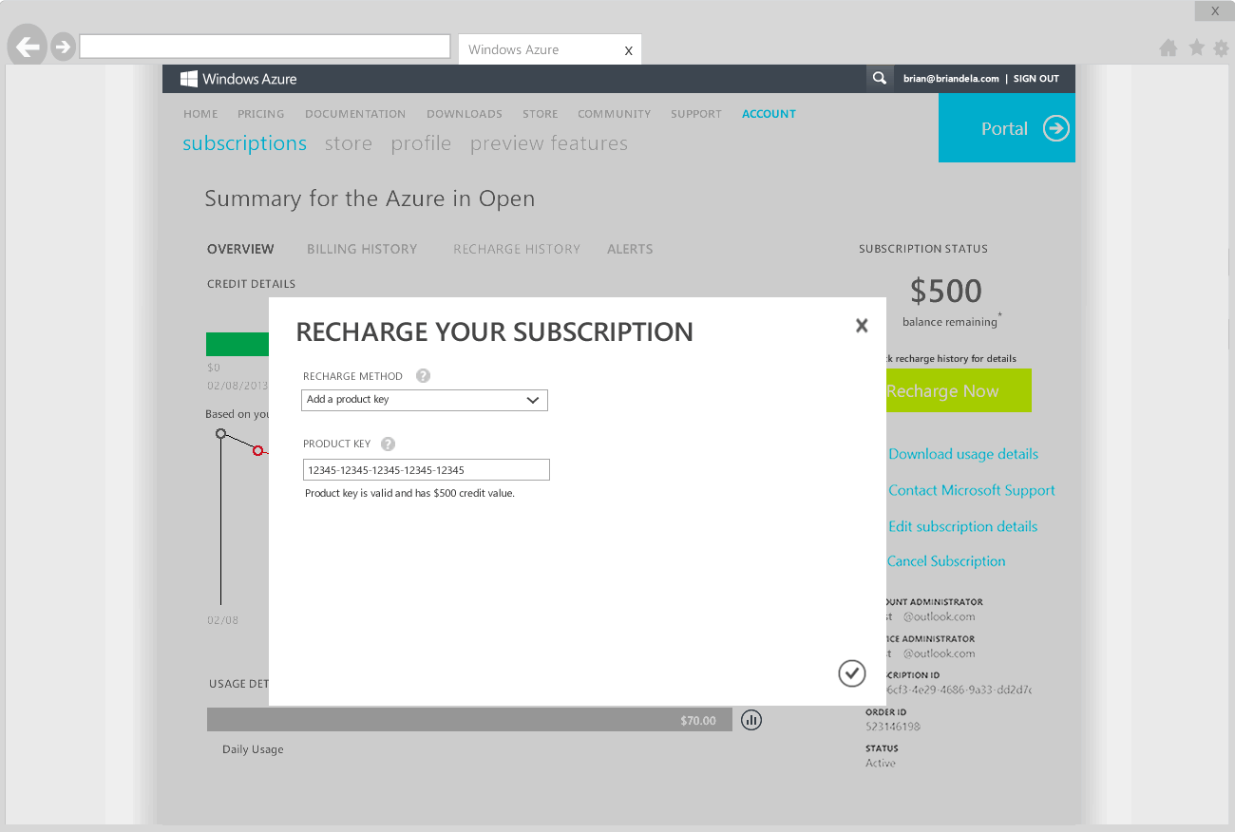

Azure in Open: Setup and Portal Experience
Credits for base azure consumption
1
2
3
4
VERIFICATION
ACTIVATION
MANAGEMENT
RENEWAL
Customer completes verification process
Reseller or customer activates credit with token from VLSC
Reseller or customer views account status and sets up balance alerts
Reseller or customer renews when 12-month period ends or balance is consumed
Renewal process (preferred)
For Emergencies
Purchase order
EDI/ MOET
Customer
tops up account using credit card.*
Clicks on “recharge now” in Azure portal and credit card option is available.
Reseller recommends renewal
Distributor
Order is placed
Reseller/customer receives email with link to VLSC and Azure portal
Customer obtains 5x5 token key from VLSC
Customer adds key under “Add Azure Credits” in Azure portal
*Credit card top up will be available shortly after launch
Notes:
I’m going to take you though a double click on the setup & portal experience after the VLSC. After following the standard process for Open Licensing purchases the Azure Portal is setup.
Once the 5x5 key is obtained from the VLSC the customer and/or partner will setup an Azure account.
They go through the verification process – which many of you may be familiar with – it involves receiving a text
After this they activate the credit with the key from VLSC by pasting it into the field
They are then able to see the management portal, this is were they view the account balance, setup balance alerts, add co-administrators and make other changes
At step 4 you will see that once the balance is consumed, or it has been 12 months since the credit was activated, it’s time to renew
The preferred path for this process is that the reseller is monitoring the customer’s balance and managing their services. The partner should purchase the credit from the Disti again, going through the same process as steps 2-4 above.
Notes on preferred path:
Reseller should be named as co-admin on subscription
Reseller should receive balance alerts through Azure portal
Distributors should be monitoring account balances through consumption reports to notify reseller
In an emergency situation, for example the customer reaches a zero balance on a holiday weekend and cant reach their reseller, they will be able to top up the account with a credit card. They will still be transacting in the Open Program, and can purchase via the preferred path, from their reseller, for their next top up.

Slide 29
What is Azure in Open?
    Monetary commitment valid for 12 months
Applicable to any Azure Service eligible for Monetary Commitments
Business processes follow existing Online Services in Open
Notes:
You might be familiar with Open Licensing programs. Partners use Open to resell many Microsoft products and services….like Windows, and SQL Server, and Office 365. Open allows you to purchase a Microsoft product or service from your preferred distributor and resell it to your customer. You control the direct relationship. Previously, customers and partners could only purchase Azure directly from Microsoft or as part of an Enterprise Agreement (EA) with Microsoft.
Azure in Open Volume Licensing offers a new option for customers to purchase Azure Services. Customers make monetary commitments through the Open, Open Value, or Open Value Subscription Volume Licensing Program that last for 12 months. The 12-month subscription period begins with the redemption of an Online Service Activation (OSA) Key that a reseller purchases from a distributor and sells to a customer.
Once an OSA Key is purchased and redeemed, customers can spend its value on any consumption-based Azure service.
Azure in Open will be available on August 1, 2014 with a price list preview on July 1, 2014.

Slide 30
Selling Hybrid Cloud
Capitalize on the opportunity
Speed up the time to deal closure
Get additional revenue streams
Eliminate competition with differentiated solution
Notes:
Partnering with Microsoft puts you on the fast track to the cloud with the ability to broaden your customer base and create new, more profitable lines of business. Selling Azure helps you expand your role as a service provider and consultant by enabling and advising your customers as they evolve their business in the cloud. Cloud business models enable recurring revenues that help establish long-term relationships with your customers. Successful cloud partners are also able to “up-level” the services they provide into more strategic, IT-enabled business consulting.
Not all customers are ready to move 100% to the cloud. Building the solution on SnapCLOUD of flexibility to choose the right solution for your customers, whether integrating on-premises and cloud, or choosing from IaaS and PaaS. Not all customers are ready to move 100% to the cloud. That’s the beauty of a Microsoft solution that includes Azure. You can deliver Hybrid server solutions that leverage backup in the cloud, in addition to deploying applications within VMs hosted on Azure. Customers see the flexibility and agility they are looking for, and you provide the complete solution.
Take your solutions and services to market faster with a familiar development environment and ease of integration across infrastructures, apps, identities, and databases. Use your existing skills to build on Microsoft Azure and easily connect to other Microsoft products and services that your customers use. Cloud-based solutions are easier to develop, test, and take to market and also lower the barriers to entry to offer managed services.

Slide 31

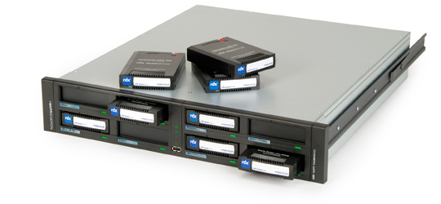

Jump Start Your Revenue Stream
*
Pay $0 for SnapCLOUD for 30 days for existing and new Snap customers
*Only on SnapCLOUD not on compute and storage by Microsoft
SnapScale
SnapServer XSR
SnapServer XSD
RDX

Slide 32
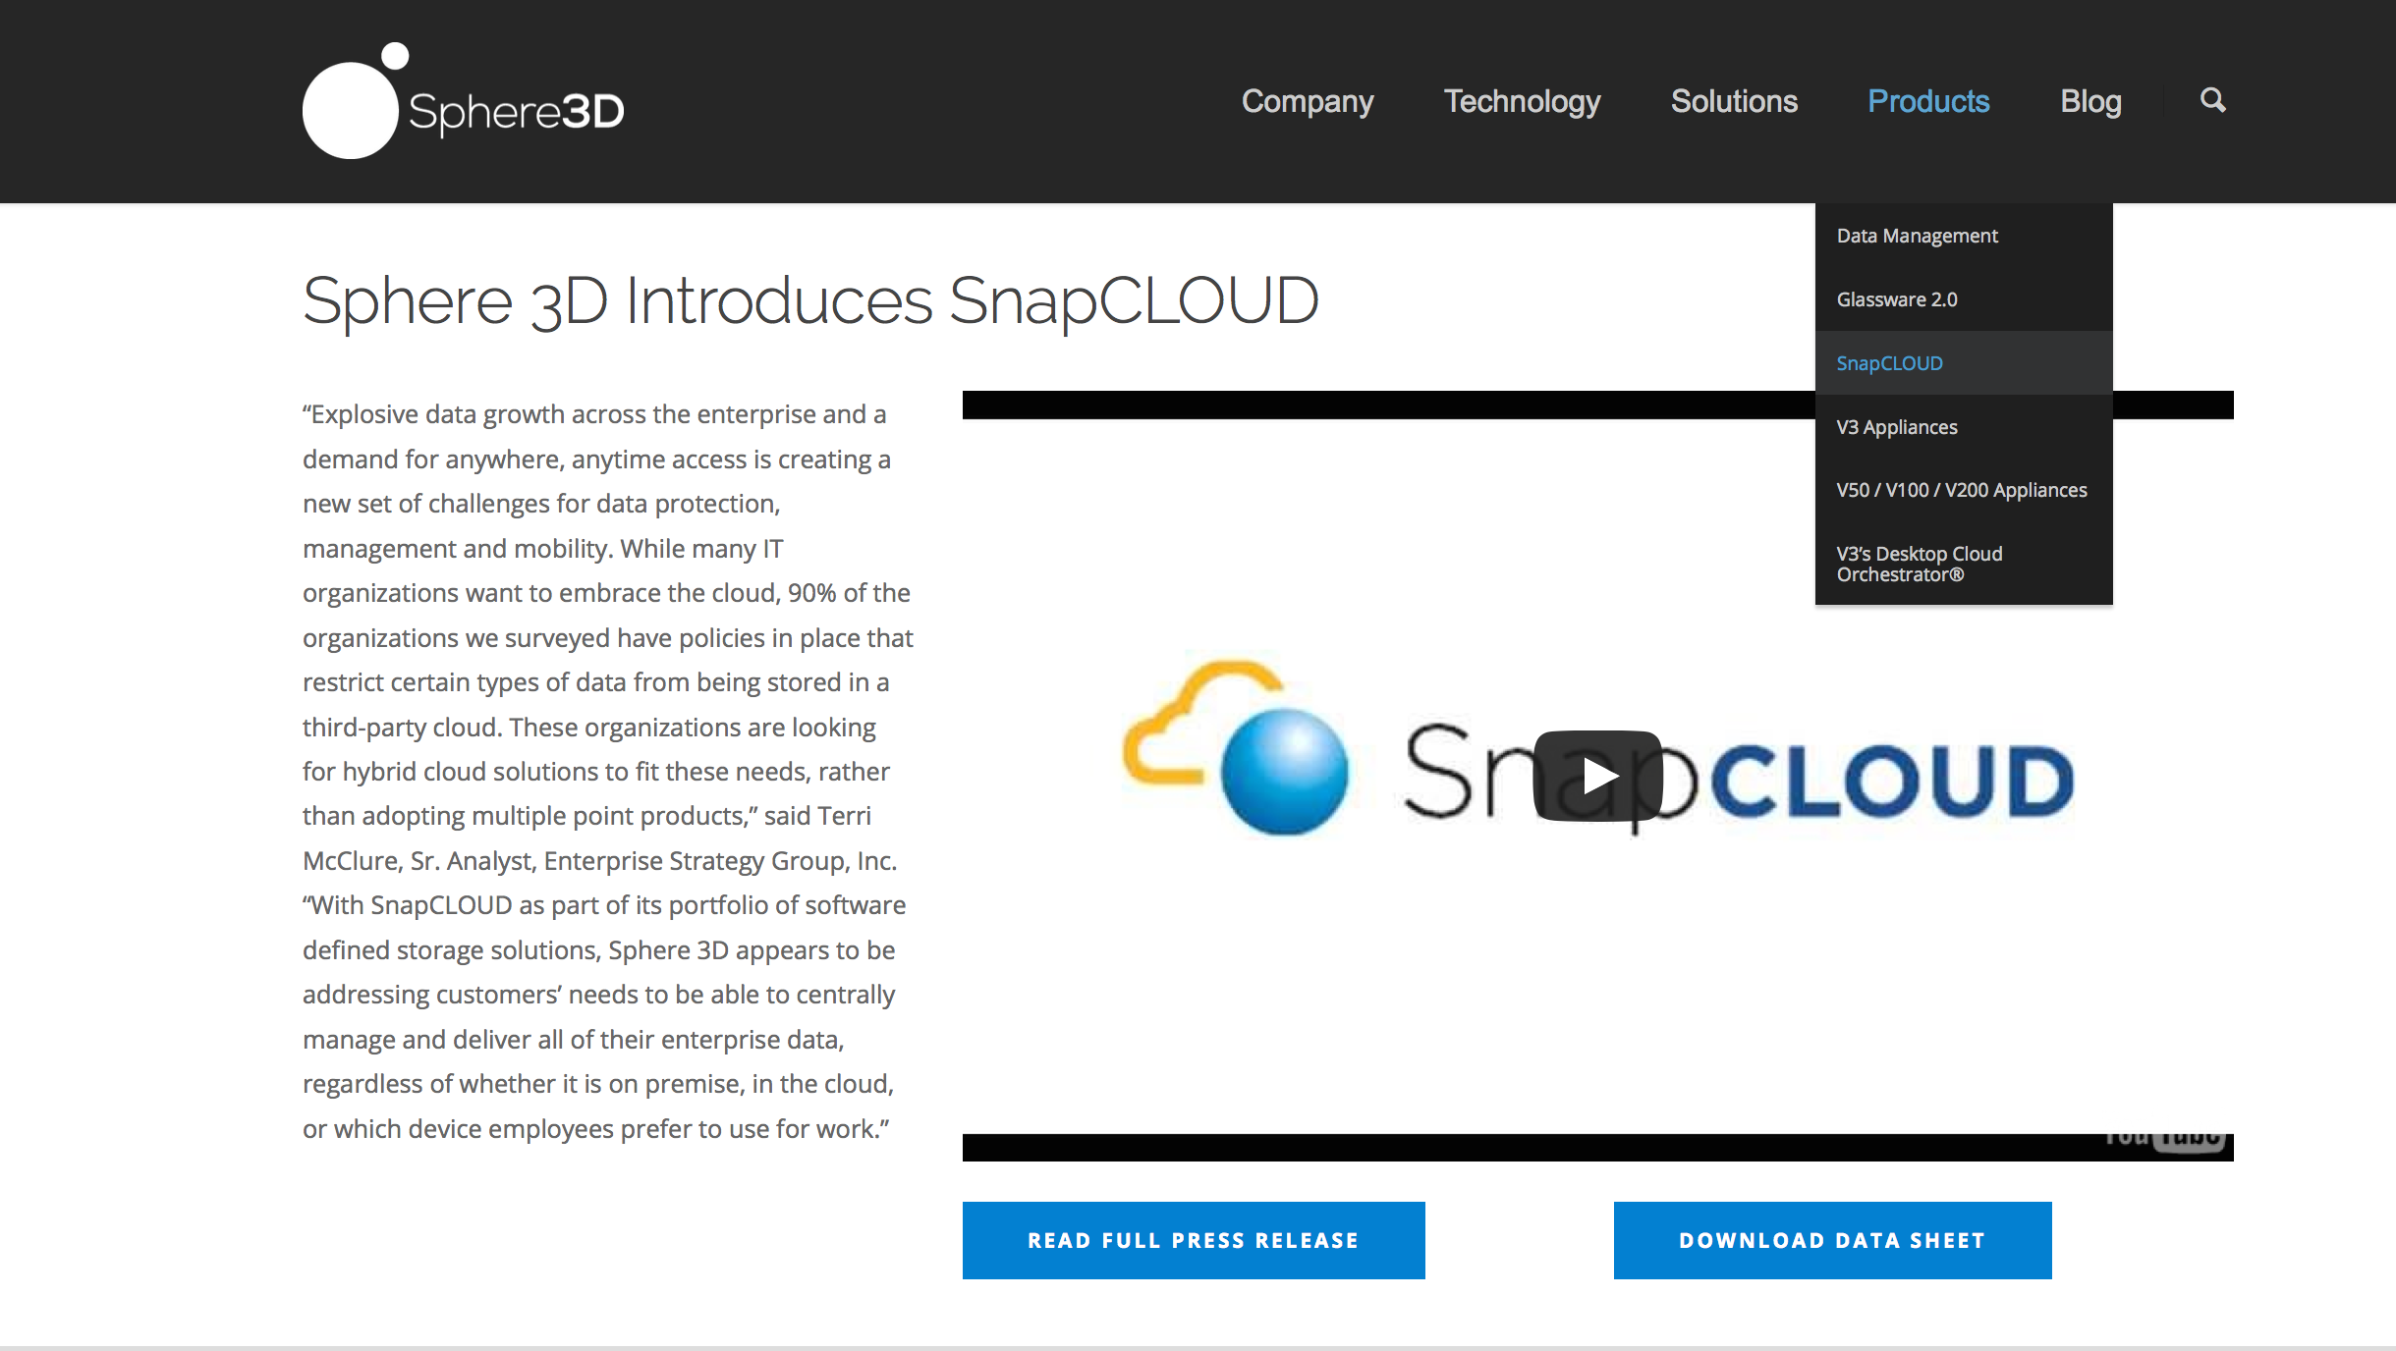
Tapping into the opportunity
Learn More
Talk to your existing Snap customers about these use cases | Bursting in the cloud DR in the cloud Secure data access any device any where
Start Testing Azure Now – Using IURs | Develop expertise now in a controlled environment using $100 of monthly Azure credits at no charge
http://sphere3d.com/snapcloud/
Notes:
When you become a Microsoft Cloud Partner, you receive a set of core benefits to help you start and build your cloud practice, including, internal-use software rights, tailored training, and prioritized exposure in Microsoft marketing and product directories.
Members of the Microsoft Partner Network Cloud Essentials program receive monthly credits of $100 of Windows Azure at no charge.

Slide 33
Reference Links
Introduction | http://sphere3d.com/snapcloud/
Datasheet | http://sphere3d.com/wp-content/uploads/2015/07/snapcloud-datasheet-071315.pdf
Administrator’s Guide | http://overlandstorage-public.hosted.jivesoftware.com/docs/DOC-3190
Frequently Asked Questions | http://community.overlandstorage.com/support/kb/snapcloud
Get Support | http://community.overlandstorage.com/

Slide 34
Thank you

Slide 35

Get Started – Next Steps for Partners
  Sign up for Ramp Up
  virtual event
  & get the technical
  skills you need
http://aka.ms/AzureOpen
http://aka.ms/
SMBLearningPath
http://aka.ms/AzureVAR
http://aka.ms/
AheadoftheGame
  Find marketing
  content
  on the Partner
  Marketing
  Center
Join the Cloud Partner Community group on Yammer
Notes:
In our last slide in the partner facing deck we recommend key resources to get partners started.
Leading up to launch we recommend that partners sign up for theRamp Up Virtual Event for sales & marketing readiness
Technical readiness will be available on-demand as well
New content will be posted on the Partner Marketing Center
And finally, the best way for partners to stay connected is by joining the Cloud Partner Community on Yammer

Slide 36
Azure Purchasing Options
Direct on azure.Microsoft.com
Open Licensing Programs
Enterprise Agreement
Pay As You Go
6- or 12-months
12-months
Longer-term
Zero upfront, cancel anytime
No long-term commitment
Monetary Commitments starting at $500/mo
Flexibility with Volume Licensing through a familiar vehicle for SMBs
Opportunity for partners to earn margins/incentives
Offers additional
discounts and terms as part of a deeper commitment to the platform
/Hour
BYOL
Vouchers
MSP
Notes:
Today Azure can be purchased either directly from Microsoft.com, or with an EA.
When Azure is available in Open, there will be another option available, and one that is familiar to tens of thousands of partners.
Each purchasing path has advantages and will be right for different types of partners and customers. Open is simply another option that has the benefits we discussed on the previous slide.

